Slide 1
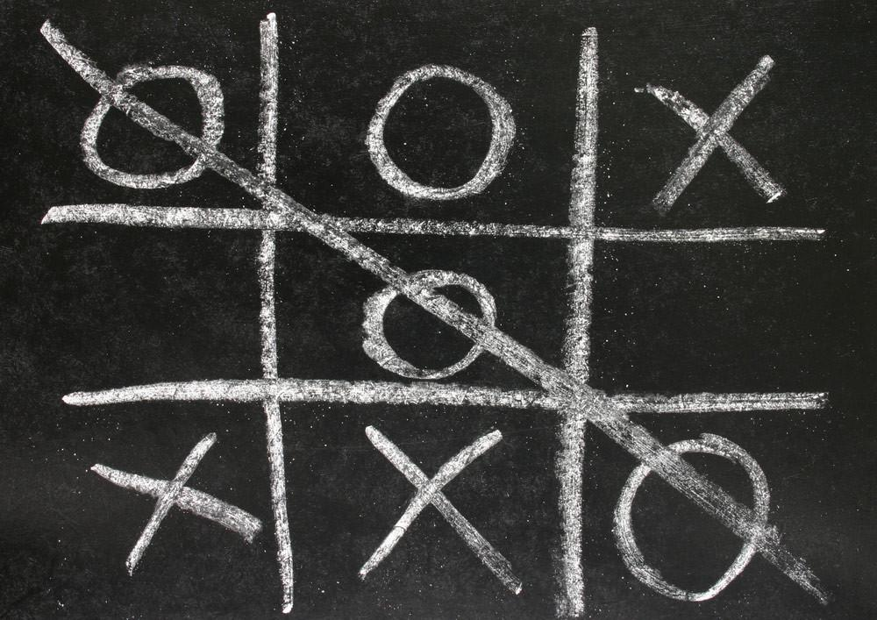
TIC TAC TOE
A GUI PROJECT
COURSE CODE: - INT213
SUBMITTED TO: - Mr. Dipen Saini
Submitted by: - Devansh Agarwal(11908637)
Ankit gupta(11903499)

Slide 2
CONTENT
OBJECTIVE
GRAPHICAL USER INTERFACE
DESCRIPTION OF THE PROJECT
SAMPLE CODE
OUTPUT
CONCLUSION OF THE PROJECT
BIBLOGRAHY

Slide 3
OBJECTIVE
The purpose of our project “TIC TAC TOE” is to make the game noughts and crosses using Graphical User Interface(GUI) which is used to be played on paper by two people at a time. In which two players use to mark noughts and crosses on a space of 3x3 grid and to give the user an interactive interface to play the game noughts and crosses on computer.

Slide 4
GRAPHICAL USER INTERFACE
Graphical User Interface: -
Graphical user interface is a form of interface that allows the users to interact with computer or electronic devices using graphical icons and audio indicator instead of using text-based user interface.
Tkinter: -
Tkinter is one of the methods of Tk GUI toolkit. Tkinter is the easiest, fastest and commonly used method to create the GUI applications. Tkinter provides various controls, such as buttons, labels and text boxes used in a GUI application. These controls are commonly called widgets.

Slide 5
DECRIPTION OF THR PROJECT
As we all know that “TIC TAC TOE” is the computerized version of the game noughts and crosses which we used to play on paper which has been played by two people at a time. In which two player are used to mark noughts or crosses on a space of 3x3 grid.
But this is the computerized version which is slightly different from that we used to play on paper because in this version we use a timer which will count from 30 seconds till 0 seconds. In this span of 30 seconds one of the player has to try his chance and if he/she tries in that span of time then the game will continue but if he/she doesn’t try in that span of time then it will show “GAME OVER” on the screen and the players need to restart the game from the starting using restart button on the screen. And if all the players try their attempt in the span of 30 seconds then it will show the name of player who has won the match or either it will show whether “X” or “O” won on the screen and if the game between the players gets draw then it will display “DRAW” on the computer screen.
Name of the player is filled on the top section given for the names of the players next to section “PLAYER1” and “PLAYER2”. Players can quit the game at any time when they want to quit the game, it all depends on the player’s decision.

Slide 6
SAMPLE CODE

Slide 7
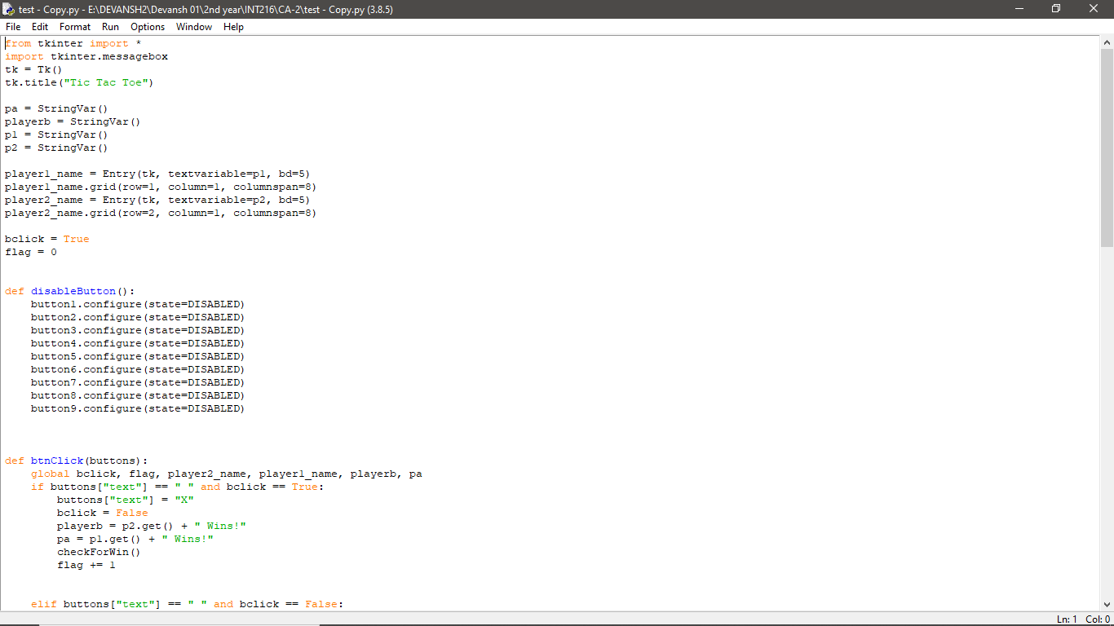

Slide 8
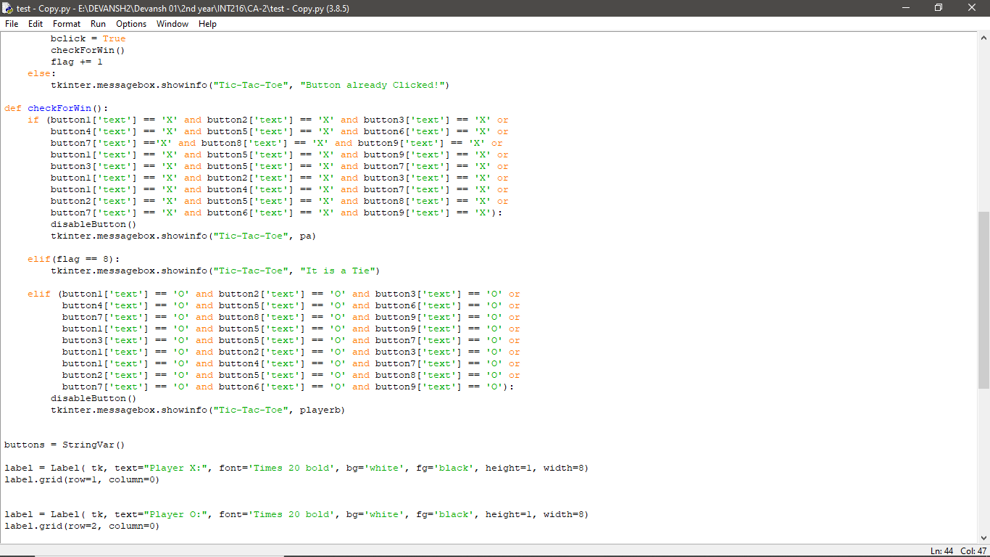

Slide 9
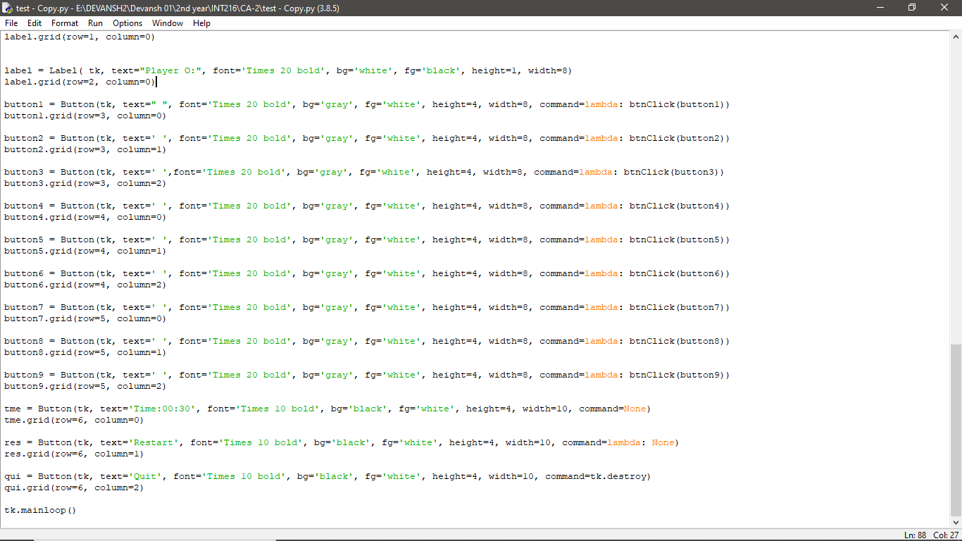

Slide 10
OUTPUT

Slide 11
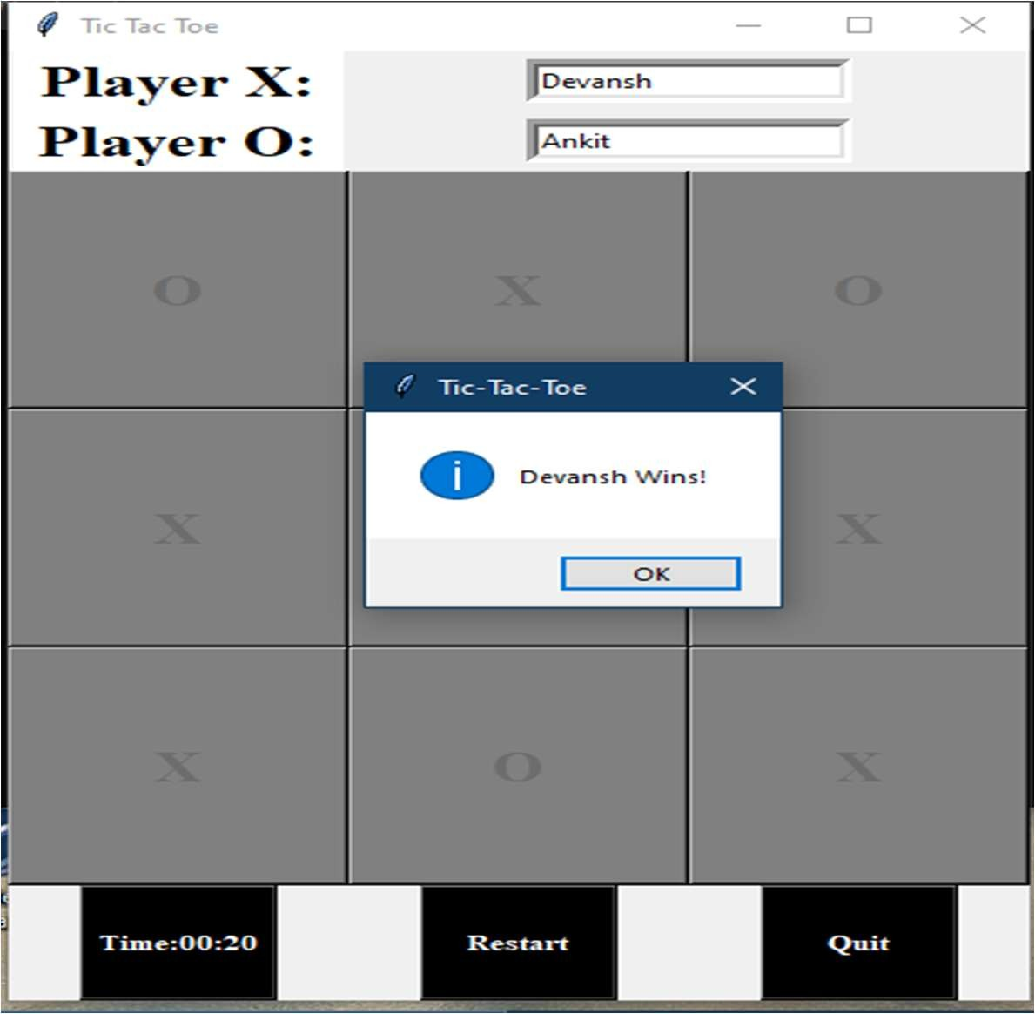
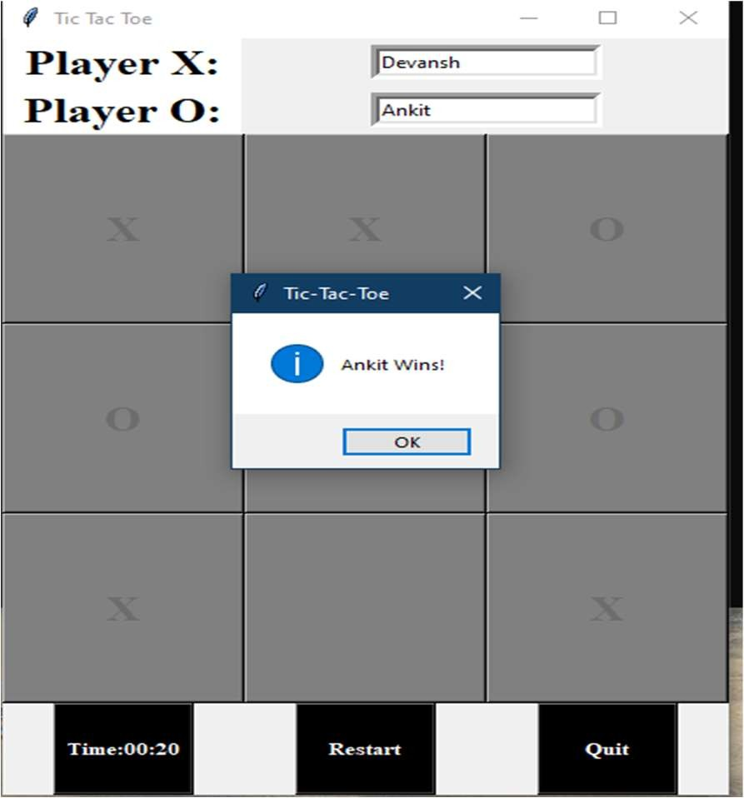

Slide 12
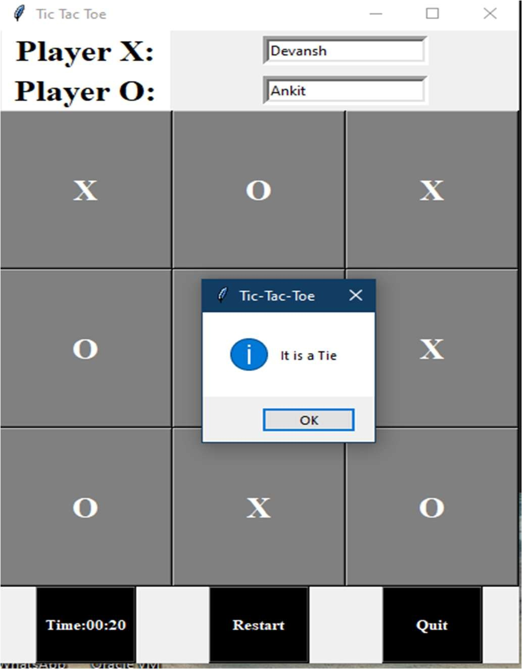

Slide 13
CONCLUSION
So, the conclusion of our project to give the player a interactive interface using Graphical User Interface(GUI) to play the noughts and crosses which is being played on a paper on a space of 3X3 grid.
We have learned many thing about GUI and how we can implement the GUI.

Slide 14
BIBLOGRAPY
Introduction to Programming using Python by Y. Daniel Liang, Pearson
Python Programming using Problem Solving Approach by Reema Thareja, Oxford University Press
https://w3schools.com
https://stackoverflow.com/
https://geeksforgeeks.com/

Slide 15
THANK YOU

